Slide 1
The Space of Real Places of ℝ(x,y)
Ron Brown
Jon Merzel

Slide 2
The Space M(ℝ(x,y))
Weakest topology making evaluation maps continuous
Subbasic “Harrison” sets of the form
{ϕ: ϕ(f)∊(0, ∞)} where f ∊ ℝ(x,y)
Well-known:
Compact
Hausdorff
Connected
Contains torus??? Disk???
Notes:
Will note the “M” notation
Franz-Viktor on containing torus

Slide 3
Our results:
The space is actually path connected.
For each (isomorphism class of) value group, the set of all corresponding places is dense.
Some large collections of mutually homeomorphic subspaces are identified.
Notes:
“isomorphism” means iso of ordered groups
Fractal character

Slide 4
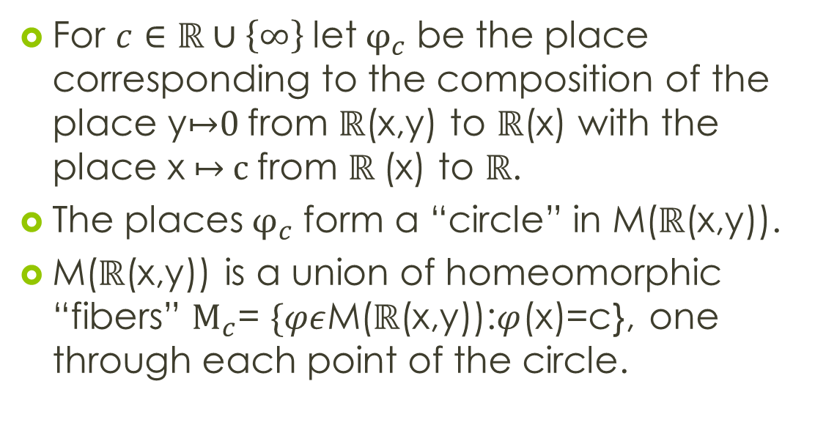
Method
For $c∈\text{ℝ}∪\left\{∞\right\} \text{let} φ_{c}$ be the place corresponding to the composition of the place y↦0 from $\text{ℝ}$(x,y) to $\text{ℝ}$(x) with the place x ↦ c from $\text{ℝ}$(x) to $\text{ℝ}$.
The places${ φ}_{c}$ form a “circle” in M($\text{ℝ}$(x,y)).
M($\text{ℝ}$(x,y)) is a union of homeomorphic “fibers” $M_{c}$= $\{φε$M($\text{ℝ}$(x,y)):$φ$(x)=c}, one through each point of the circle.
Notes:
Fibers are homeomorphic via automorphisms of R(x,y)

Slide 5
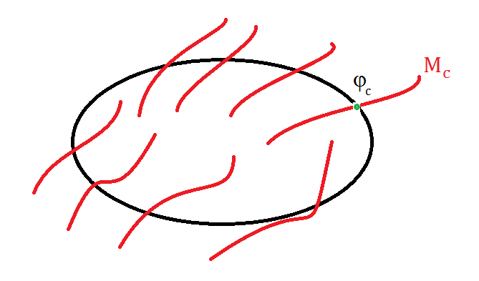

${\text{M}}_{0}$ $≅$ M$≔\text{M}$(ℝ $\left((x)) (y)\right)$.
Brown (1972) analyzes all extensions of a complete discrete rank one valuation to a simple transcendental extension.
Notes:
Brown(72) of course does much more than this

Slide 6
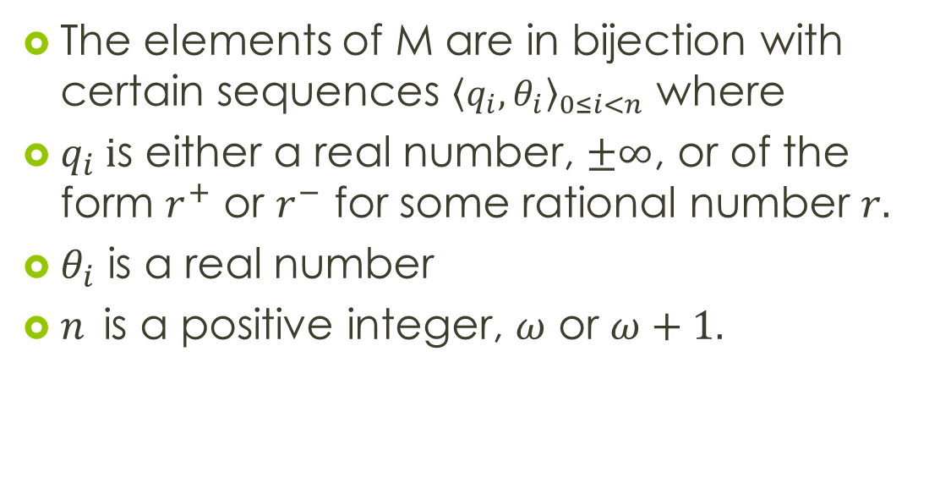
How to represent M
The elements of M are in bijection with certain sequences ${\left\langle q_{i},θ_{i}\right\rangle }_{0≤i<n}$ where
$q_{i} i$s either a real number, $±∞$, or of the form $r^{+}$ or $r^{−}$ for some rational number $r.$
$θ_{i}$ is a real number
$n$is a positive integer, $ω$ or $ω+1.$
Notes:
Can think of the q’s as lying in the group ZxRxZ
The q’s should be thought of as values in the value group, the theta’s in the residue field.
Do not confuse with places on rings allowing ∞ as a value.

Slide 7
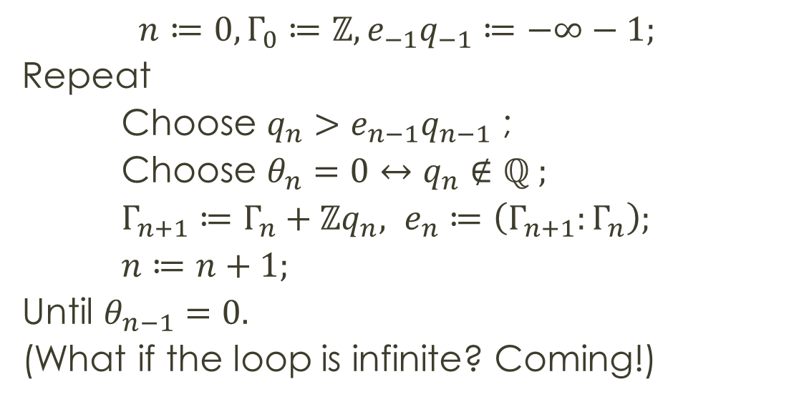
How to build a legitimate sequence
$$n≔0,Γ_{0}≔ℤ,e_{−1}q_{−1}≔−∞−1;$$
Repeat
Choose $q_{n}>e_{n−1}q_{n−1}$ ;
Choose $θ_{n}=0↔q_{n}∉$ ℚ ;
$Γ_{n+1}≔Γ_{n}+ℤq_{n}, e_{n}≔\left(Γ_{n+1}:Γ_{n}\right);$
$n≔n+1;$
Until $θ_{n−1}=0.$
(What if the loop is infinite? Coming!)
Notes:
n accumulates length of sequence
Gamma accumulates value group (generated by 1 and the q’s)
Initializing e_-1 q_-1 just means there is no restriction on q_0
Process either stops with nonrational q and theta = 0 or goes on forever

Slide 8
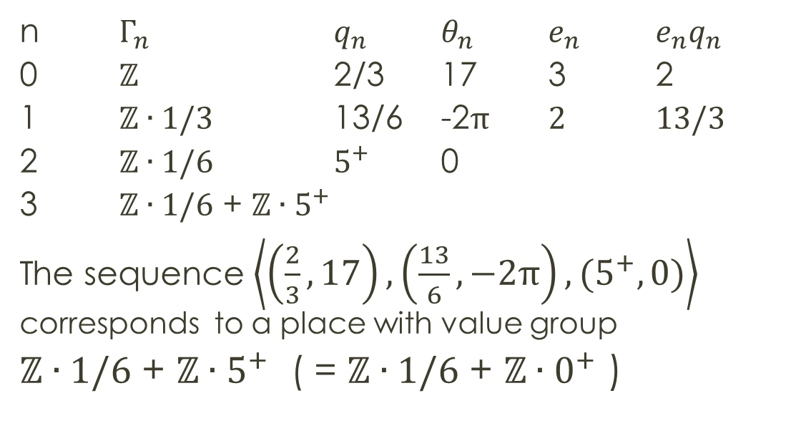
Example
n $Γ_{n}$ $q_{n}$ $θ_{n}$ $e_{n}$ $e_{n}q_{n}$
0 $ℤ$ 2/3 17 3 2
1 $ℤ∙1/3$ 13/6 -2π 2 13/3
2 $ℤ∙1/6$ $5^{+}$ 0
3 $ℤ∙1/6$ + $ℤ∙5^{+}$
The sequence $\left\langle \left(\frac{2}{3},17\right),\left(\frac{13}{6},−2\text{π}\right),(5^{+},0)\right\rangle$ corresponds to a place with value group
$ℤ∙1/6$ + $ℤ∙5^{+}$ ( = $ℤ∙1/6$ + $ℤ∙0^{+}$ )
Notes:
“e punches q into gamma”

Slide 9

Infinite length sequences
If $e_{i}=1$ for all large $i$ then we set the length $n=ω+1 and q_{ω}=∞.$
Otherwise $n=ω$.
In both cases, $Γ_{n}=ℤ+\sum_{i<n}{{ℤ∙q}_{i}}$

Slide 10

How to picture M
The set of possible pairs $\left\langle q,θ\right\rangle$ can be pictured as follows:
Break the real line at a rational $q$ and join the two rays with a circle.

Slide 11
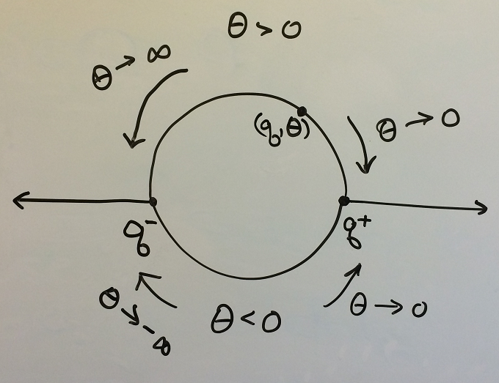
Notes:
The labelling on the circle is motivated by topological considerations

Slide 12
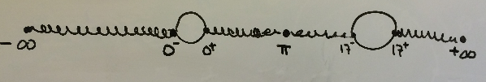
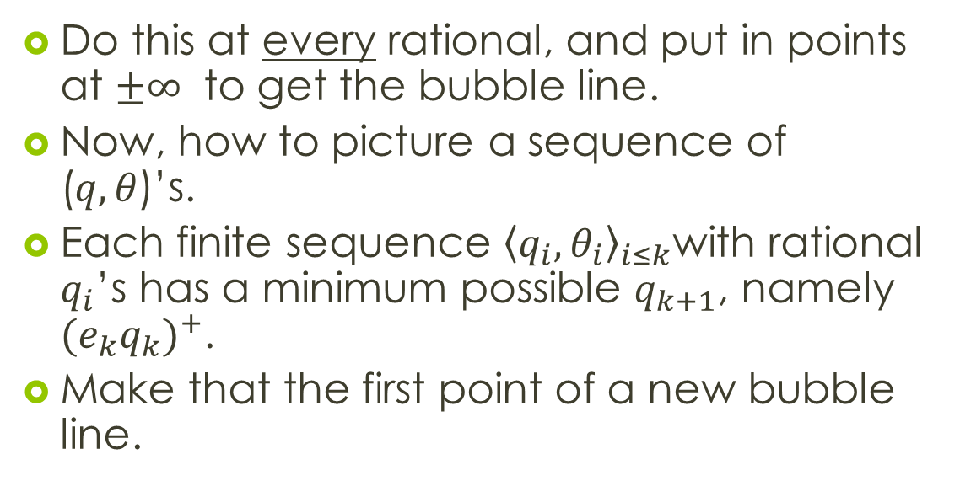
Do this at every rational, and put in points at $±∞$ to get the bubble line.
Now, how to picture a sequence of ($q,θ$)’s.
Each finite sequence ${\left\langle q_{i},θ_{i}\right\rangle }_{i≤k}$with rational $q_{i}$’s has a minimum possible $q_{k+1}$, namely ${(e_{k}q_{k})}^{+}$.
Make that the first point of a new bubble line.

Slide 13
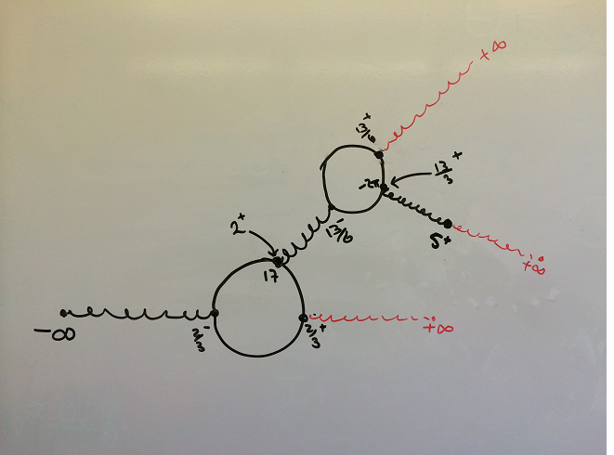
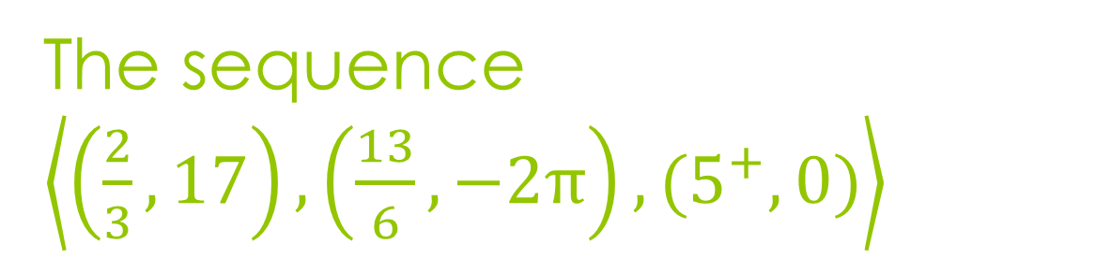
The sequence $\left\langle \left(\frac{2}{3},17\right),\left(\frac{13}{6},−2\text{π}\right),(5^{+},0)\right\rangle$
The infinite bedspring

Slide 14
The points of M
Finite sequences corresponding to points of M can be pictured (uniquely) as points on the infinite bedspring.
Infinite sequences corresponding to points of M can be visualized (uniquely) as infinite “paths” through the infinite bedspring.
The topology on the bedspring (induced by the Harrision topology via the bijection) is a little technical.

Slide 15
Path connectedness
If you keep only the top or bottom half of each circle, the “half-bubble line” becomes a linearly ordered set, and the induced topology is the order topology.
With that topology, the half-bubble line is homeomorphic to a closed interval on the real line.
Stitching together pieces corresponding to closed intervals gives us paths.

Slide 16
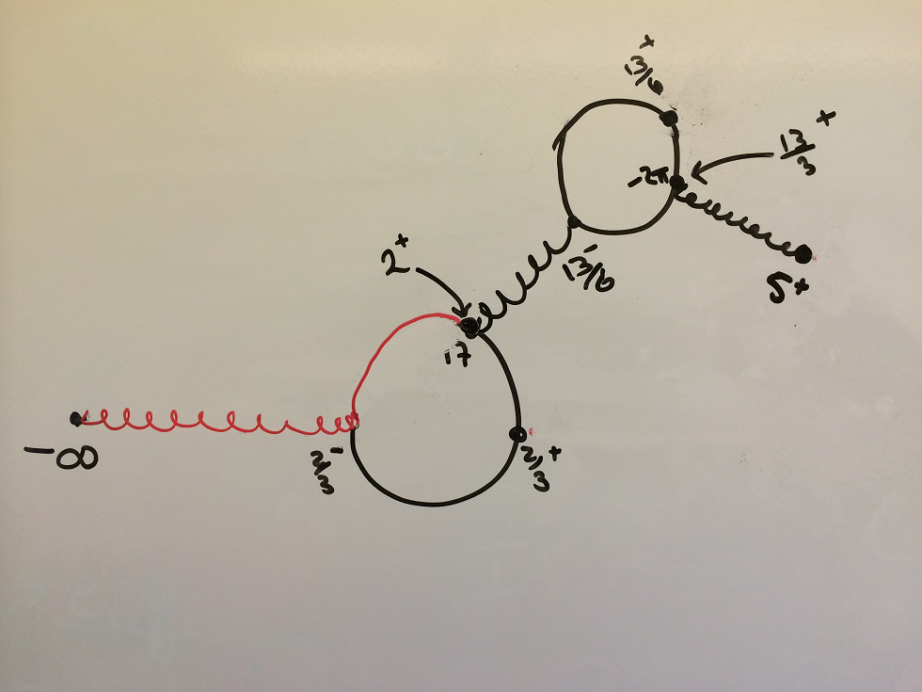

Slide 17
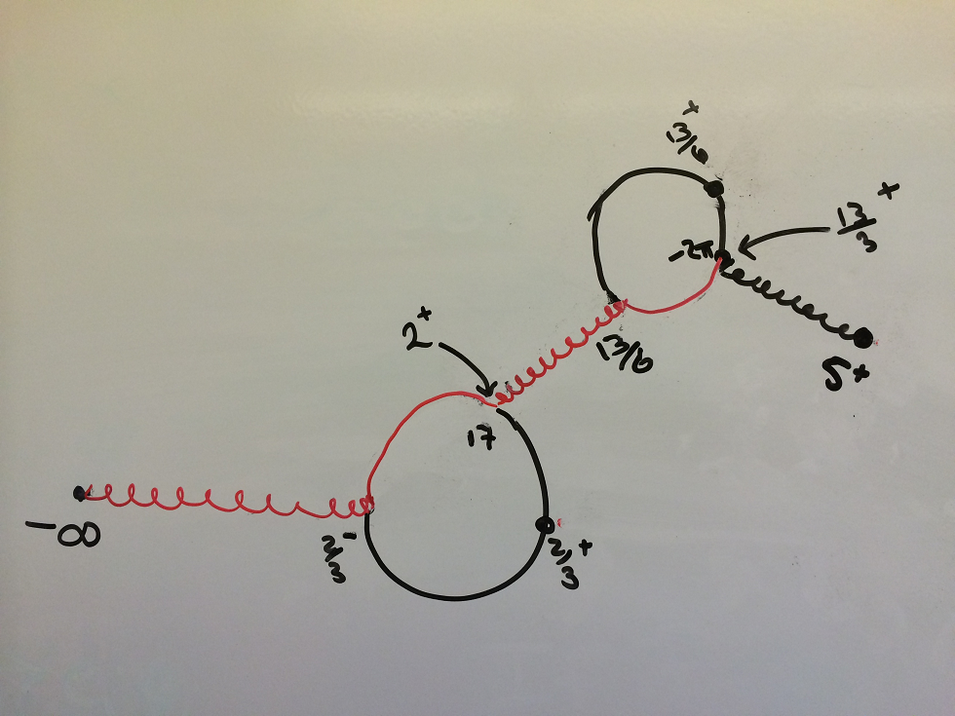

Slide 18
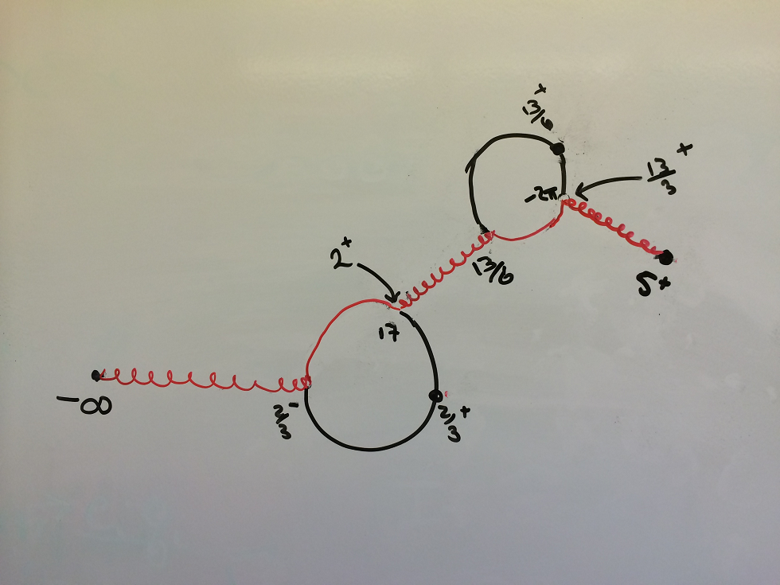

Slide 19
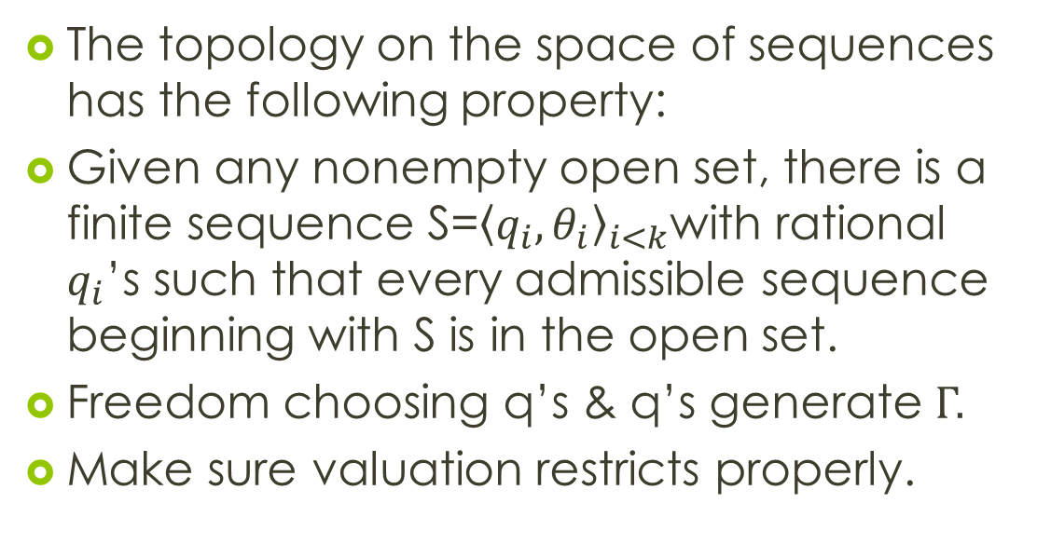
Density
The topology on the space of sequences has the following property:
Given any nonempty open set, there is a finite sequence S=${\left\langle q_{i},θ_{i}\right\rangle }_{i<k}$with rational $q_{i}$’s such that every admissible sequence beginning with S is in the open set.
Freedom choosing q’s & q’s generate Γ.
Make sure valuation restricts properly.
Notes:
Discrete rank one case is trickier as it isn’t a value group in M, but one can devise places in M that restrict to d.r.o. on R(x,y)

Slide 20
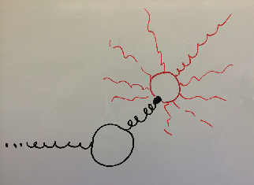

Self-similarity
Look at all sequences with common start ${\left\langle q_{i},θ_{i}\right\rangle }_{i<k}$with rational $q_{i}$’s and with $q_{k}≥q>e_{k−1}q_{k−1}$ where $q∈ℚ$is fixed.
These all look the same!
(Checking the topology is a messy case-by-case computation)
Notes:
Can also take q_k >= q- , q_k >= q+, q_k > q+

Slide 21
Under the bijection between the set of legitmate signatures and M, this set of signatures corresponds to a certain subbasic open set, determined by a choice of an irreducible polynomial and a sufficiently large rational number.

Slide 22
The bijection can be established via “strict systems”
Closely related to the “saturated distinguished chains” of Popescu, Khanduja et al

